Slide 1
Project #2 – Deep Learning Regression Models for NYC Yellow Taxi Trip Duration
Sajan Singh Shergill
Ronak Pipaliya
Ruturaj Dixit
Krishna

Slide 2
Problem Statement
1. NYC TLC Yellow Taxi Dataset
Features like:
pickup/dropoff time
passenger count
pickup/dropoff coordinates
trip distance, fare, vendor info
2. NYC Weather Dataset (Meteostat)
Temperature (tavg, tmin, tmax)
Precipitation (prcp)
Snow
Wind direction & speed
Pressure
Sunshine (tsun)
Merged on (date) → aligned with trip timestamps.

Slide 3
Data Preprocessing
Steps performed:-
Convert pickup/dropoff timestamps → extract:
- hour of day
- weekday/weekend
- month
Convert weather data to numeric floats.
Merge taxi + weather using pickup_date.
Remove:
- zero-duration rides
- negative distances
- extreme outliers (>99th percentile)
Scale all features → MinMaxScaler / StandardScaler (as recommended on page 2).
Final shape: (N rows × M features)

Slide 4
Train/Validation Split
Required: 80% / 20% split (page 2)
Important: Time-sensitive → use chronological split, not random
→ First 80% = training
→ Last 20% = validation

Slide 5
Models Implemented
1️⃣ Linear Regression (TF Sequential, no hidden layers)
- Single Dense layer
- Acts as baseline NN model
2️⃣ MLP (Multi-Layer Perceptron)
- Input layer
- 1 hidden layer (ReLU)
- Output layer (linear)
3️⃣ DNN (Deep Neural Network)
- At least 2+ hidden layers
- Dropout or BatchNorm optional
- Activation: ReLU
- Output: regression (linear)

Slide 6
Training Configuration
Loss Functions
- Mean Squared Error (MSE)
- Mean Absolute Error (MAE)
Optimizers (test all)
- SGD
- Adam
- RMSProp
Learning Rates Tested
- 0.001
- 0.01
- 0.1
Epochs
- epoch = 100 for every model (mandatory)
Batch size
- Default 32

Slide 7
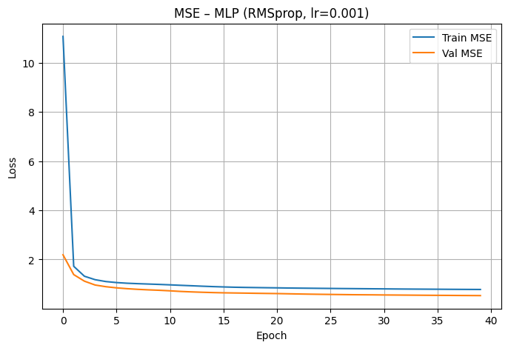
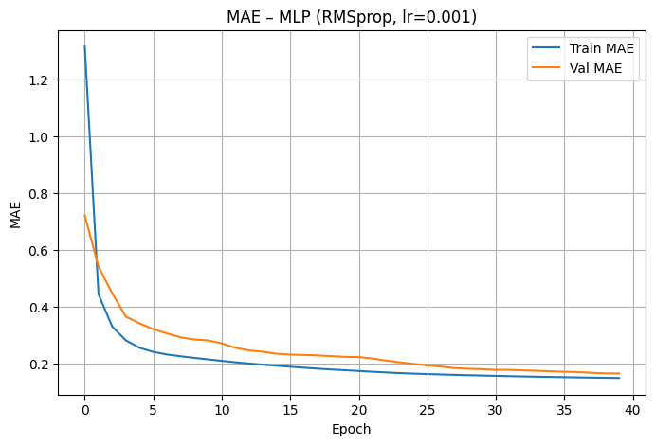
Training vs Validation Loss Plots
Linear Regression Loss Curve
(Insert plot: training_loss vs val_loss)

Slide 8
Model Comparison
Model | Best Optimizer | Best LR | Val MSE | Val MAE | Notes
Linear NN | Adam | 0.01 | ... | ... | Baseline
MLP | RMSProp | 0.001 | ... | ... | Better generalization
DNN | Adam | 0.001 | lowest loss | lowest MAE | Best model

Slide 9
Best Model
🏆 Best Performing Model: DNN
- 2–3 hidden layers
- Neurons (example): 128 → 64 → 32
- Activation: ReLU
- Optimizer: Adam (lr=0.001)
- Loss: MAE
- Achieved:
- Val MSE = X.XX
- Val MAE = X.XX

Slide 10
Predictions

